Slide 1
Trauma-Informed Care
children.wi.gov
Milwaukee Child Advocacy Center
Children’s hospital of wisconsin

Slide 2
Thinking about our families/clients
Making the Child Advocacy Center a “one stop shop” to reduce stress – many partners
Space for individuals to relax/library
Separate parking for clients
Security
Central check in area
Waiting room

Slide 3
Thinking about our families/clients
(Continued)
Trying to reduce telling stories over and over again (re-traumatizing)
Medical evaluations
Advocates
Forensic Interviews
Psychotherapy

Slide 4
Medical Evaluations
Meeting as a team every morning to game plan and discuss potential issues
Helping patients better understand what appointment will look like
Including Child Life Specialist
Ensuring a safe environment
Client has control; not forced to do anything

Slide 5
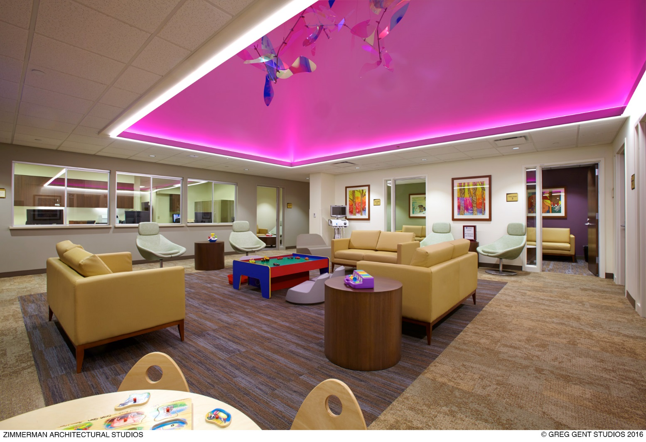
Advocates
Ensuring all members present for the appointment have support
Meeting with families in a private room (connected to waiting area), allowing visibility to children
Recognize the strengths of families
Validation

Slide 6
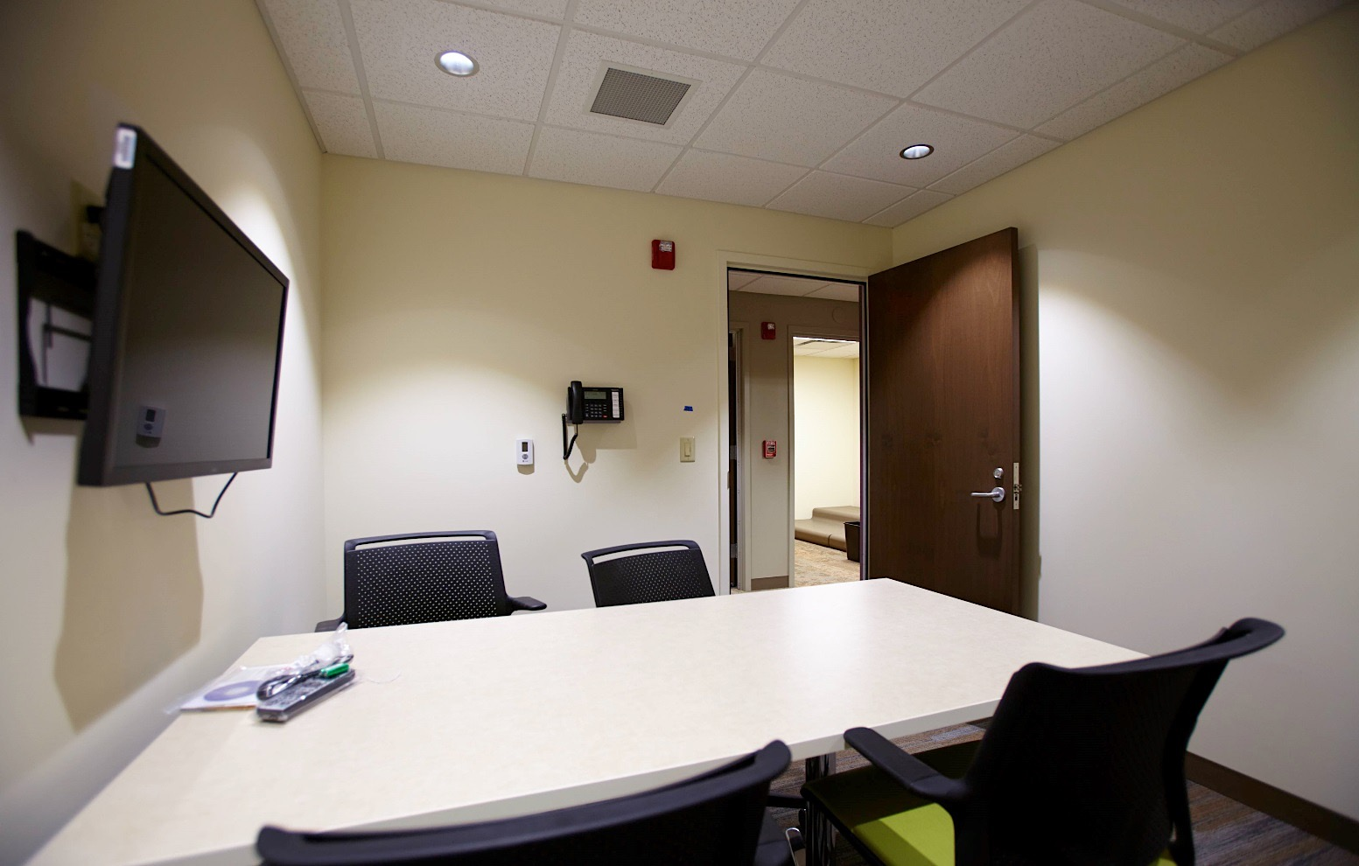
Forensic interviews
Observation rooms, allowing for others to view and ask questions
Being open and honest about recording, viewers, etc.
Show clients what observation room looks like

Slide 7
Psychotherapy
Added in a new therapist role
Providing education to families directly in the CAC
Allowing families to meet therapist on site before scheduling
Improved scheduling process
Using models to address trauma (TF-CBT)

Slide 8
Thinking about our employees
Sanctuary
Involvement in groups: recognition, team building, communication and self-care
Wellness: on site acupuncture, EAP, wellness fair, etc.
Shared break room
Joint training spaces/conference rooms
Furniture, storage

Slide 9
Opportunities to grow
Learning as we go and needing to make changes throughout the process
Money/budget
Space
Hiring

Slide 10
Next steps
Workforce development; ensuring we are setting our clients up for success
Continuing to work on outcomes and evaluations
Building “audits”
Educating staff
Ensuring everyone realizes the impact trauma can have
Ensuring everyone can recognize the symptoms of trauma

Slide 11
Thank you
Kelee Dangles, MA, LPC
Kdangles@chw.org

