Slide 1
Creating Safe Spaces
children.wi.gov
Dane County Department of Human Services
Trauma-Informed Environment

Slide 2
Creating our Environment
Our journey began in March 2016 when our agency decided to participate in the Fostering Futures Trauma-Informed Care Initiative.
We decided to focus on two specific areas:
Workforce Development
Trauma Informed Environments

Slide 3
Creating our Environment
Visit to another county
Looked at our spaces with a new “lens”
Involved our administrators
Conducted a survey of our consumers
Used feedback from a foster parent trained in Heart Math

Slide 4
Challenges
Money/budgetary restraints
Understanding of importance
Existing building restraints
Bureaucracy
Lack of trauma awareness relating to environments

Slide 5
Creating our Environment
Who helped us:
Local contracted agencies
Linus Project/Madison Quilters
Youth Groups for Art
UW-Madison Art Department
Madison Public Library
Volunteers to “adopt” rooms/spaces
Our internal Sunshine Club

Slide 6
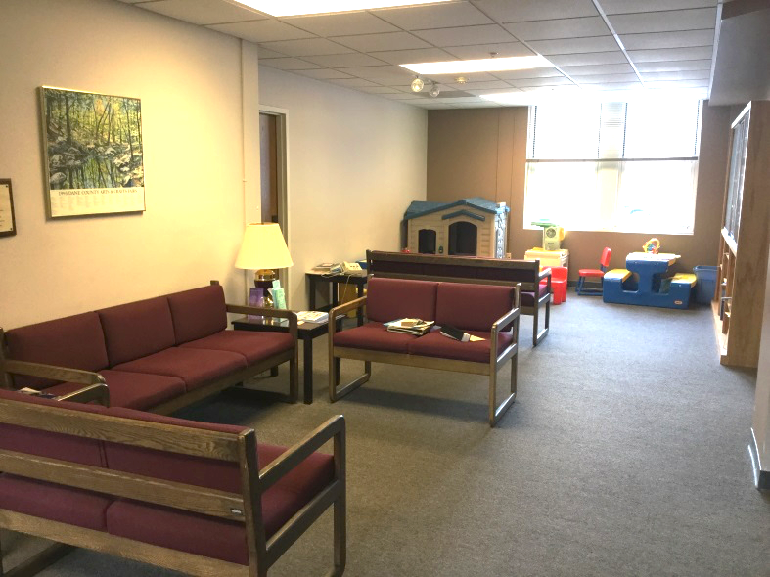
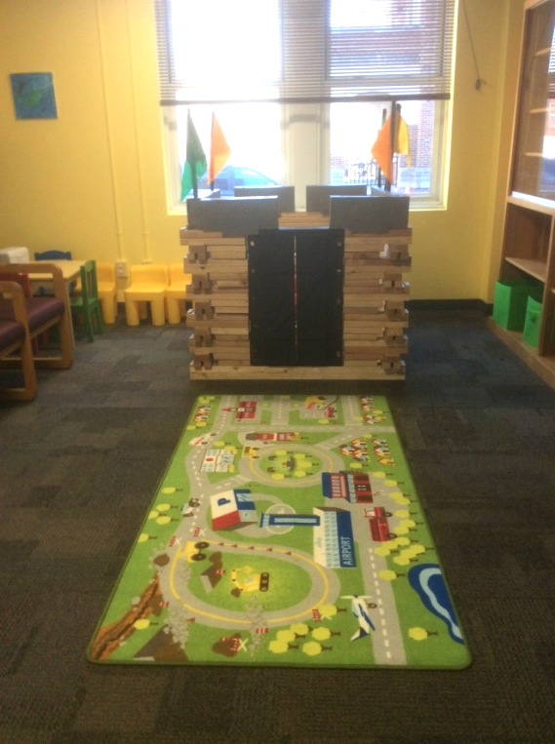
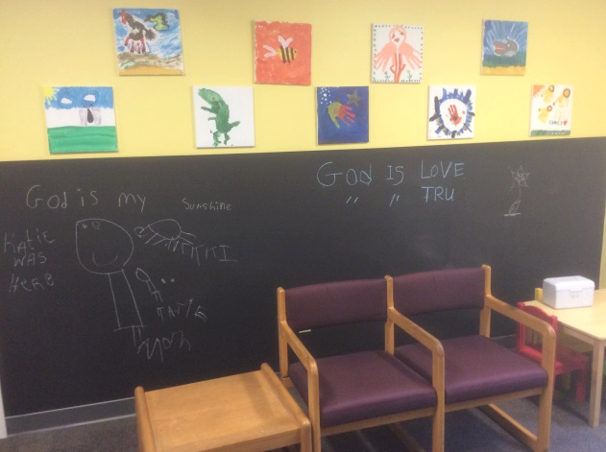
Lobby
Before:
After:

Slide 7
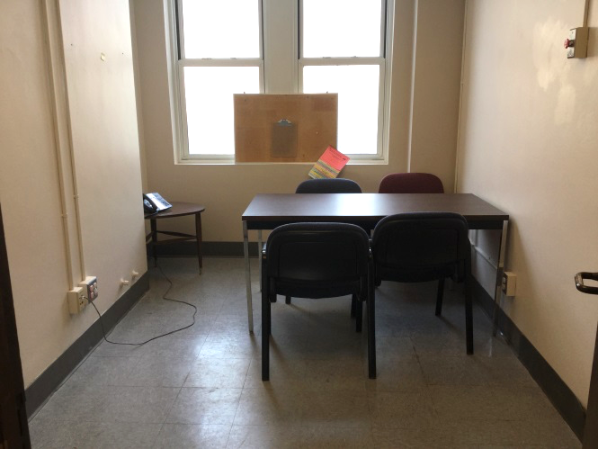
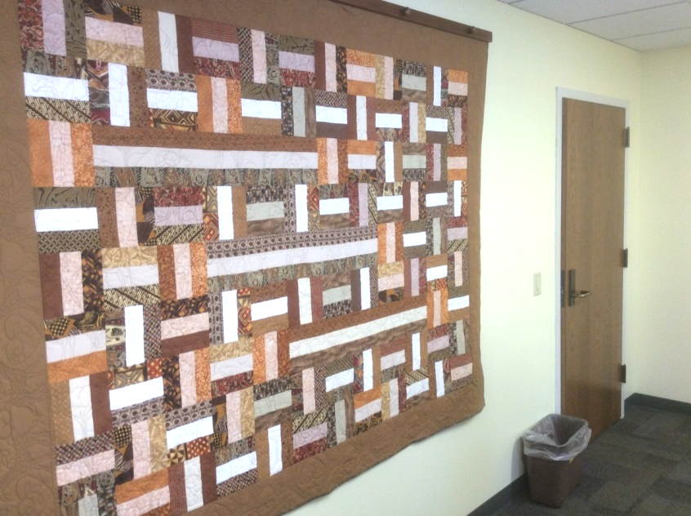
Interview Rooms
Before:
Rooms were cold and unwelcoming.
After:
A little artwork and paint go a long way.

Slide 8
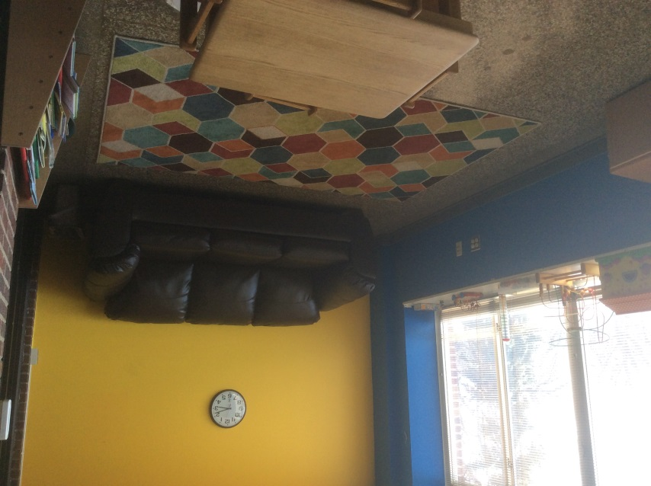
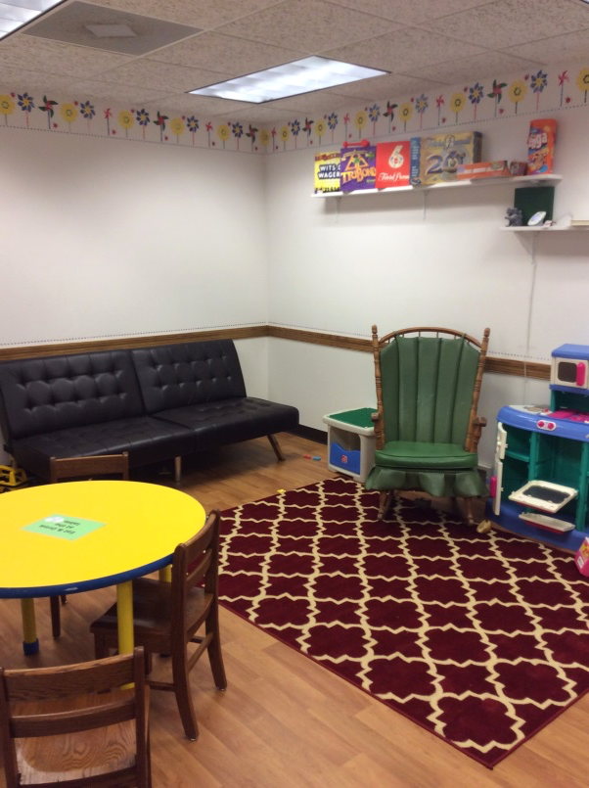
Visitation Rooms
Before:
After:
Now our family spaces are more inviting.

Slide 9
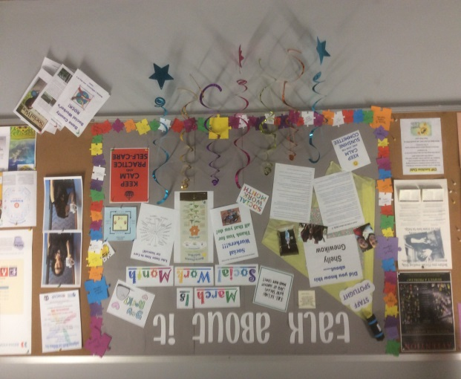
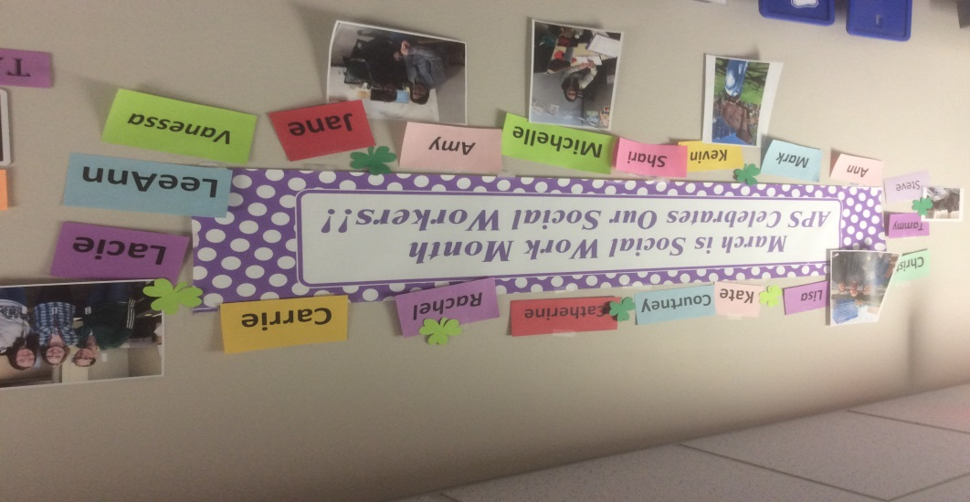
Wall Space
Staff have used creativity to decorate our bulletin boards with positive and fun messages.

Slide 10
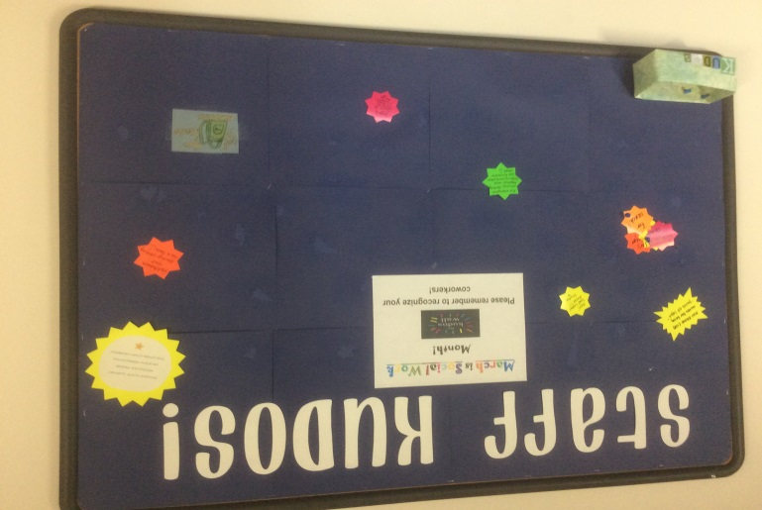
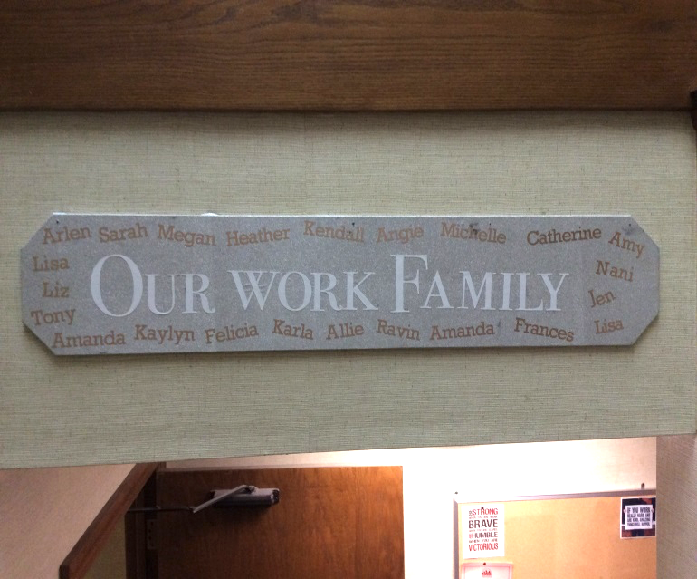
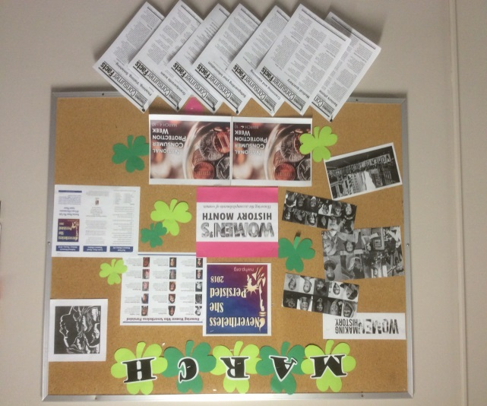
Wall Space

Slide 11
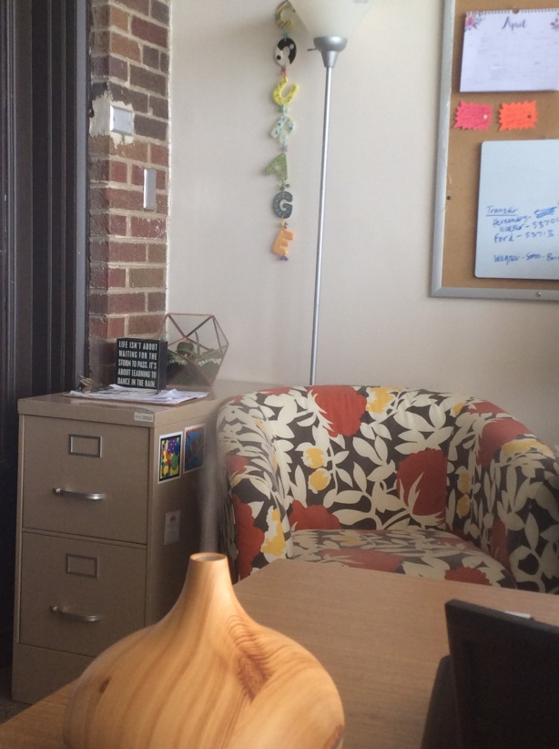
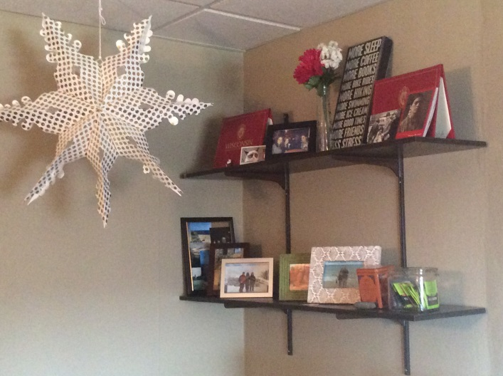
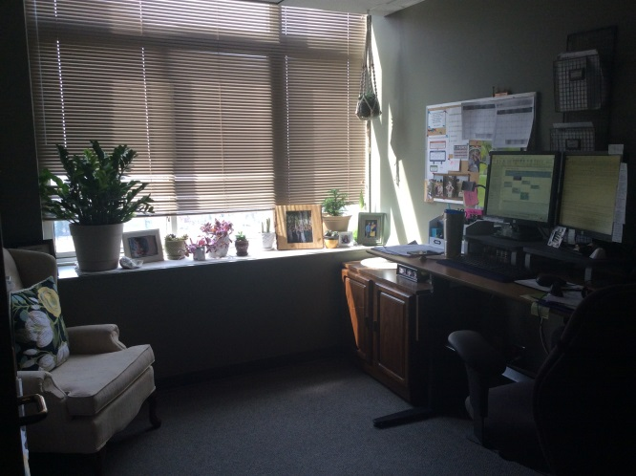
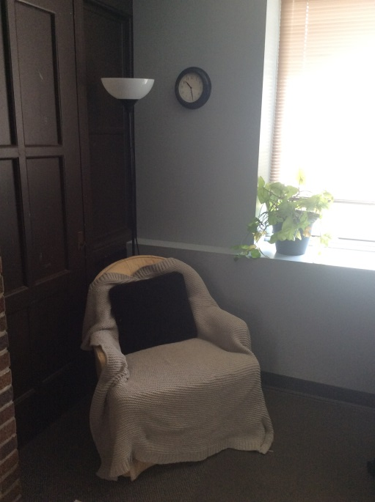
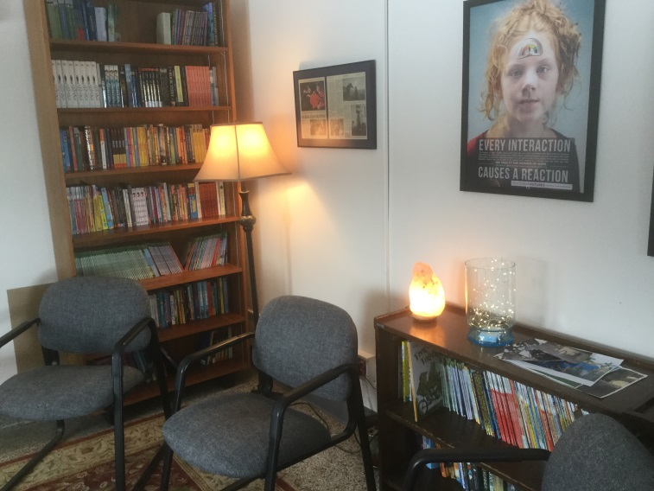
Offices

Slide 12
NIP – Youth Justice Office
The Bubbler, in collaboration with the Neighborhood Intervention Program and FauHaus, presents an art exhibition by Madison youth. MASK OFF brought together UW-Madison staff, Teen Bubbler, and teenagers of greater Madison to celebrate identity, alter egos, and human complexity.
MASK OFF is a permanent installation at the Neighborhood Intervention Program headquarters in Madison, WI

Slide 13
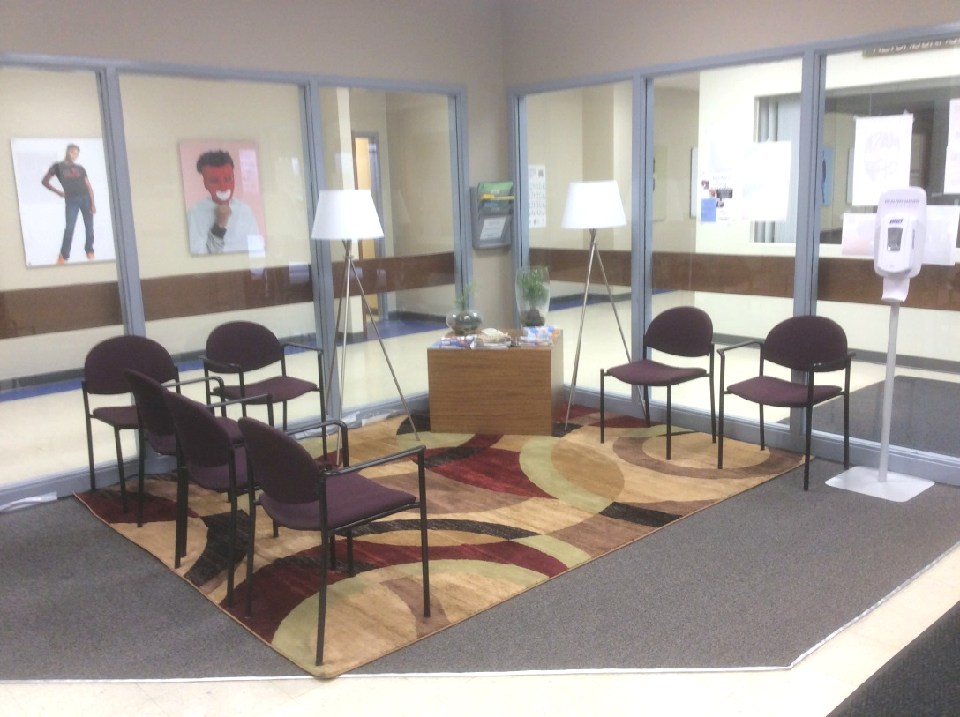
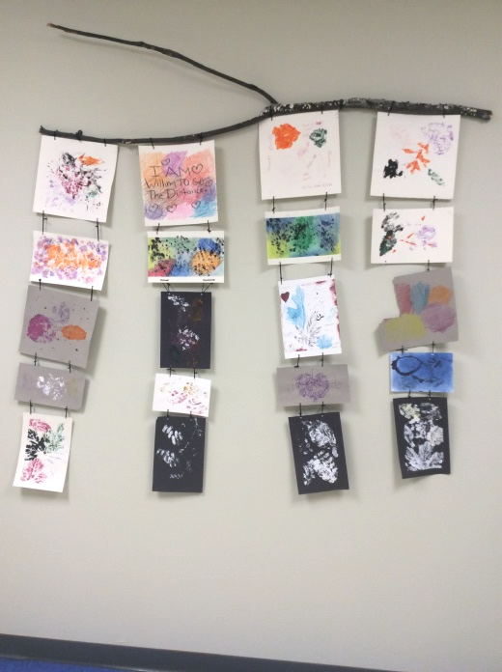
NIP – Youth Justice Office

Slide 14
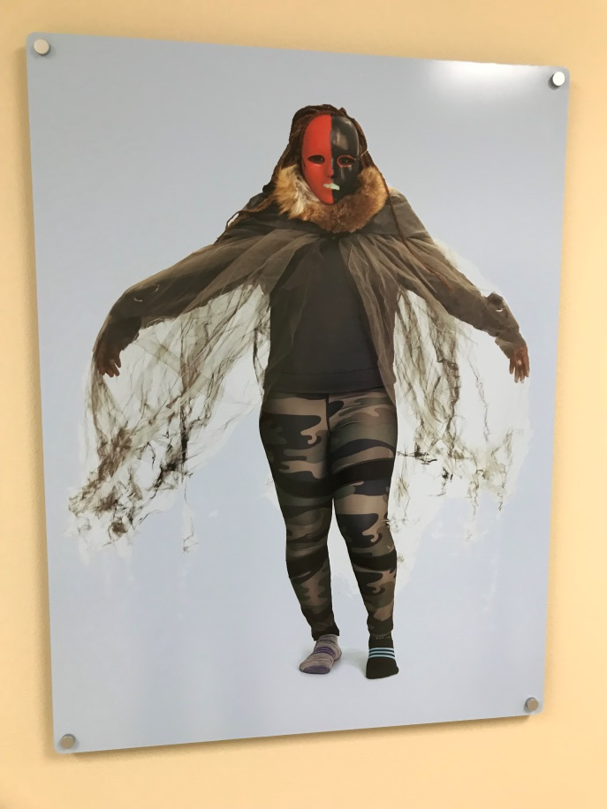
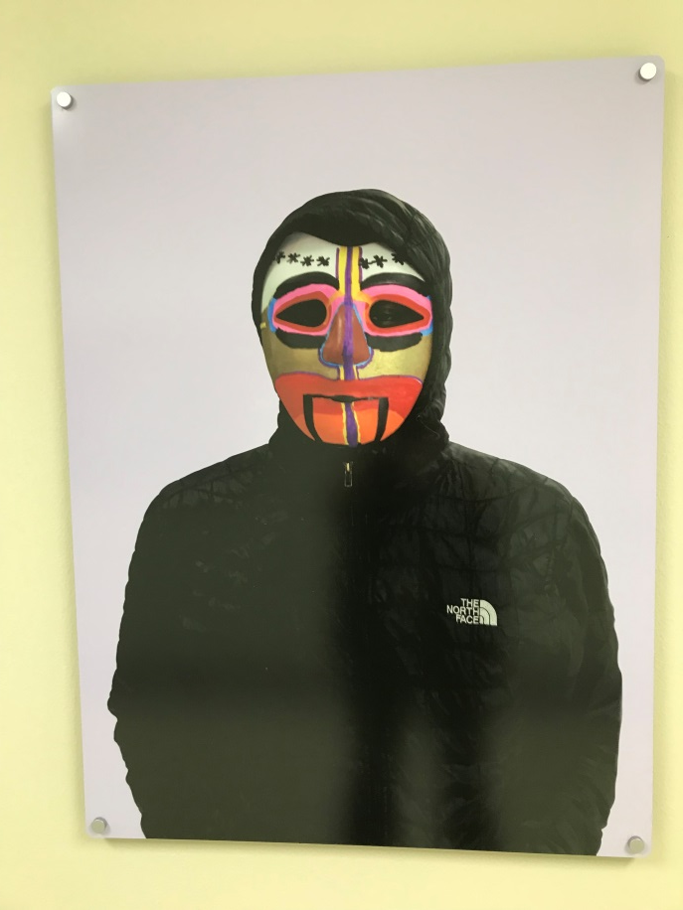
NIP – Youth Justice Office

Slide 15
Effects
“I am so appreciative of the opportunity to have my office space painted with a warm blue color. The fresh coat of paint has made the space feel more inviting, more home like and more mine ☺ My co-worker and I have added a rug and rocking chair in our space as well.
“In a job that can be often demanding and emotionally draining it is nice to come back to a space that feels comfortable and safe.”
- Staff

Slide 16
Next Steps
Proactive conversations with our County Board
Creation of proposal for Trauma Care Budget Line
Continuing changes/updates to our physical spaces
Ongoing training and education for staff and leadership

Slide 17
Thank you!
Sarah Lawton
Lawton@countyofdane.com
Lisa Hankes
Hankes@countyofdane.com

